Slide 1
David M. Kroenke and David J. Auer
Database Processing:
Fundamentals, Design, and Implementation
Chapter Two:
Introduction to Structured Query Language

Slide 2
Chapter Objectives II
Built-in functions of SUM, COUNT, MIN, MAX, and AVG
GROUP BY clause
HAVING clause
retrieve data from multiple tables
  Using SUBQUERY
  Using JOIN

Slide 3
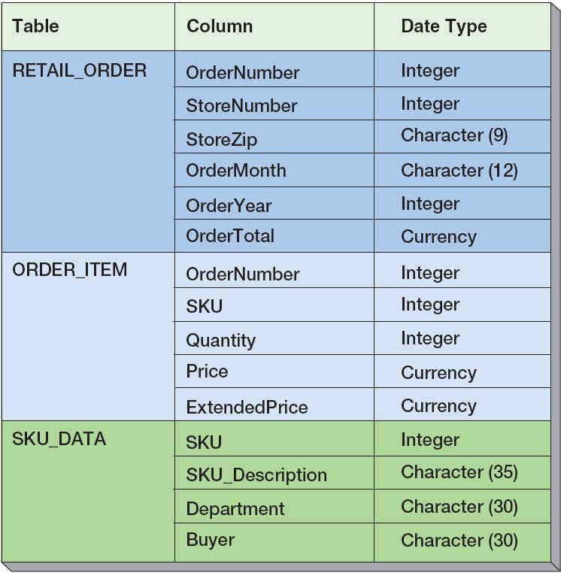
Extracted Retail Sales Data Format

Slide 4
The SQL SELECT Statement
The fundamental framework for SQL query states is the SQL SELECT statement.
  SELECT {ColumnName(s)}
  FROM {TableName(s)}
  WHERE {Conditions} ;

Slide 5
WHERE Clause Options—
LIKE and Wildcards
The SQL keyword LIKE can be combined with wildcard symbols:
  _ = exactly one character
  % = any set of one or more characters

Slide 6
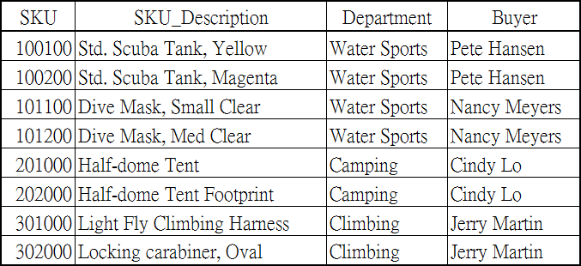

WHERE Clause Options—
LIKE and Wildcards
SELECT *
FROM SKU_DATA
WHERE Buyer LIKE 'Pete%';

Slide 7

WHERE Clause Options—
LIKE and Wildcards
SELECT *
FROM SKU_DATA
WHERE SKU_Description LIKE '%Tent%';

Slide 8

WHERE Clause Options—
LIKE and Wildcards
SELECT *
FROM SKU_DATA
WHERE SKU LIKE '%2__';

Slide 9
驗收時間
作業檢討
開考~~~

Slide 10
SQL Built-In Functions
There are five SQL built-in functions:
  COUNT
  SUM
  AVG
  MIN
  MAX

Slide 11
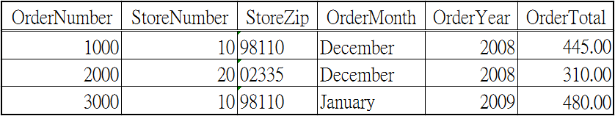

SQL Built-In Functions
SELECT SUM (OrderTotal)
FROM RETAIL_ORDER;

Slide 12

SQL Built-In Functions
SELECT SUM (OrderTotal)
AS OrderSum
FROM RETAIL_ORDER;

Slide 13
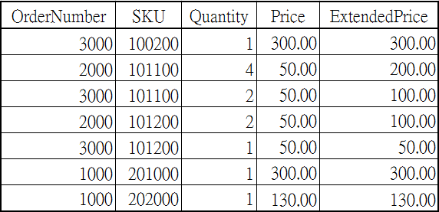

SQL Built-In Functions
SELECT SUM (ExtendedPrice)
AS Order3000Sum
FROM ORDER_ITEM
WHERE OrderNumber = 3000;

Slide 14

SQL Built-In Functions
SELECT SUM (ExtendedPrice) AS OrderItemSum,
AVG (ExtendedPrice) AS OrderItemAvg,
MIN (ExtendedPrice) AS OrderItemMin,
MAX (ExtendedPrice) AS OrderItemMax
FROM ORDER_ITEM;

Slide 15

SQL Built-In Functions
SELECT COUNT(*) AS NumberOfRows
FROM ORDER_ITEM;

Slide 16

SQL Built-In Functions
SELECT COUNT(Department) AS DeptCount
FROM SKU_DATA;
?與前面的 count(*)有何不同?
?我會想要個數?還是種類?
8

Slide 17
SQL Built-In Functions
SELECT COUNT(DISTINCT Department)
AS DeptCount
FROM SKU_DATA;

Slide 18
Limitations to built-in function
Combine with a table column name
SELECT Department, COUNT(*)
FROM SKU_DATA;

Slide 19
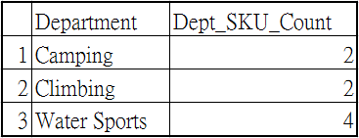
The SQL Keyword GROUP BY
SELECT Department, COUNT(*) AS
Dept_SKU_Count
FROM SKU_DATA
GROUP BY Department;

Slide 20

The SQL Keyword GROUP BY
SELECT Department, Buyer,COUNT(*) AS
Dept_Buyer_SKU_Count
FROM SKU_DATA
GROUP BY Department, Buyer;

Slide 21
The SQL Keyword
GROUP BY
SELECT Department, Buyer,
COUNT(*) AS
Dept_Buyer_SKU_Count
FROM SKU_DATA
GROUP BY Department;

Slide 22

The SQL Keyword GROUP BY
SELECT Department, COUNT(*) AS
Dept_SKU_Count
FROM SKU_DATA
WHERE SKU <> 302000
GROUP BY Department
ORDER BY Dept_SKU_Count;

Slide 23
Limitations to built-in function
Using in WHERE clause
SELECT *
FROM RETAIL_ORDER
WHERE OrderTotal > AVG(OrderTotal);

Slide 24

The SQL Keyword GROUP BY
SELECT Department, COUNT(*) AS
Dept_SKU_Count
FROM SKU_DATA
WHERE SKU <> 302000
GROUP BY Department
HAVING COUNT (*) > 1
ORDER BY Dept_SKU_Count;

Slide 25
The SQL Keyword ORDER
SELECT
FROM
WHERE
GROUP BY
HAVING
ORDER BY

Slide 26
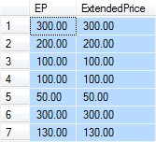
Arithmetic in SELECT Statements
SELECT Quantity * Price AS EP,
ExtendedPrice
FROM ORDER_ITEM;

Slide 27
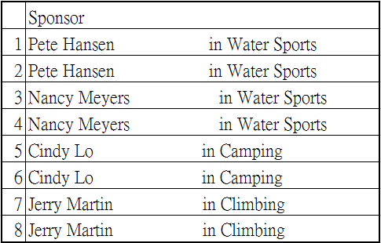
String Functions in SELECT Statements
SELECT Buyer + ' in ' + Department AS Sponsor
FROM SKU_DATA;

Slide 28

String Functions in SELECT Statements
SELECT DISTINCT RTRIM (Buyer)
+ ' in ' + RTRIM (Department) AS Sponsor
FROM SKU_DATA;

Slide 29
The SQL Keyword ORDER
SELECT
FROM
WHERE
GROUP BY
HAVING
ORDER BY

Slide 30

Querying Multiple Tables:
Subquery
SELECT SUM (ExtendedPrice) AS Revenue
FROM ORDER_ITEM
WHERE SKU IN
(SELECT SKU
FROM SKU_DATA
WHERE Department = 'Water
Sports');
查詢WaterSport已賣出的總價

Slide 31
試想一
如果我要查詢:
某個日期(例如2009年
一月)有哪些人
買了我們家產品，
有沒有辦法查到?

Slide 32

Querying Multiple Tables: Subqueries
SELECT Buyer
FROM SKU_DATA
WHERE SKU IN
(SELECT SKU
FROM ORDER_ITEM
WHERE OrderNumber IN
(SELECT OrderNumber
FROM RETAIL_ORDER
WHERE OrderMonth ='January'
AND OrderYear = 2009));

Slide 33
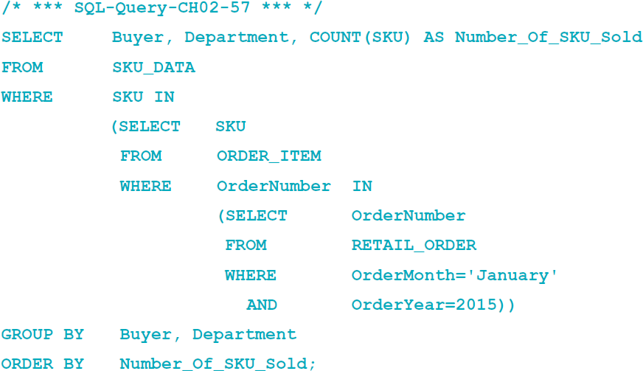
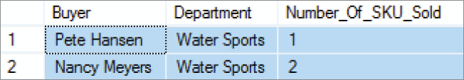
Querying Multiple Tables with SQL Subqueries

Slide 34
試想二
如果我要查詢:
每位客戶花了多少
錢，購買我的產品?

Slide 35
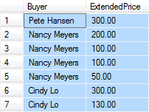
Querying Multiple Tables:
Join
SELECT Buyer, ExtendedPrice
FROM SKU_DATA, ORDER_ITEM
WHERE SKU_DATA.SKU = ORDER_ITEM.SKU;
同一個名字分很多次出現?
給我加好的吧!

Slide 36

Querying Multiple Tables:
Joins
SELECT Buyer, SUM(ExtendedPrice)
AS BuyerRevenue
FROM SKU_DATA, ORDER_ITEM
WHERE SKU_DATA.SKU = ORDER_ITEM.SKU
GROUP BY Buyer
ORDER BY BuyerRevenue DESC;

Slide 37
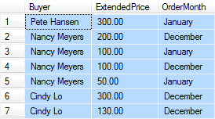
Querying Multiple Tables:
Joins
SELECT Buyer, ExtendedPrice, OrderMonth
FROM SKU_DATA, ORDER_ITEM, RETAIL_ORDER
WHERE SKU_DATA.SKU = ORDER_ITEM.SKU
AND ORDER_ITEM.OrderNumber =
RETAIL_ORDER.OrderNumber;

Slide 38
Subqueries versus Joins
Subqueries and joins both process multiple tables.
A subquery can only be used to retrieve data from the top table.
A join can be used to obtain data from any number of tables.

Slide 39
Querying Multiple Tables with SQL Joins
In an SQL join operation, the SQL JOIN operator is used to combine parts or all of two or more tables.
  Explicit join ─ the SQL JOIN operator is used as part of the SQL statement.
  Implicit join ─ the SQL JOIN operator is not used as part of the SQL statement.

Slide 40
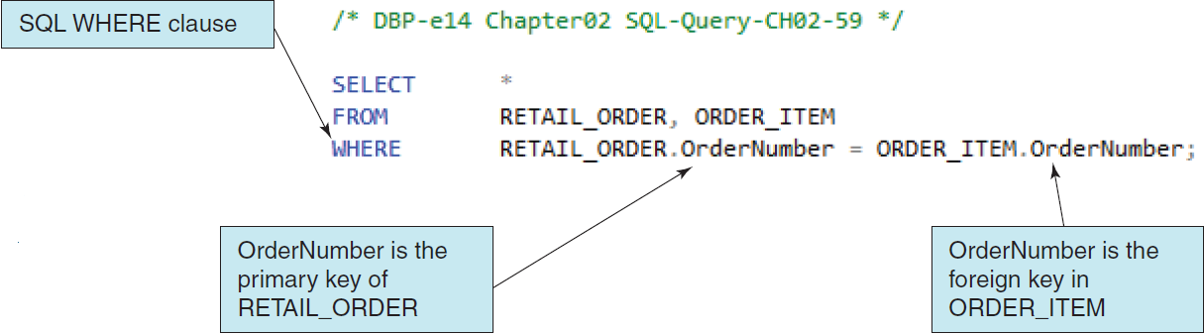
Implicit INNER JOIN
By selecting rows by matching by the primary key values of one table with the foreign key values of a second table, we produce an SQL INNER JOIN.
Because the SQL JOIN keyword does not appear in the SQL statement, this is an implicit join.

Slide 41
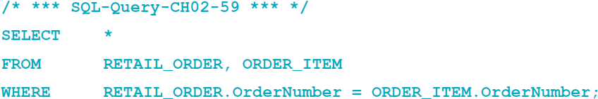
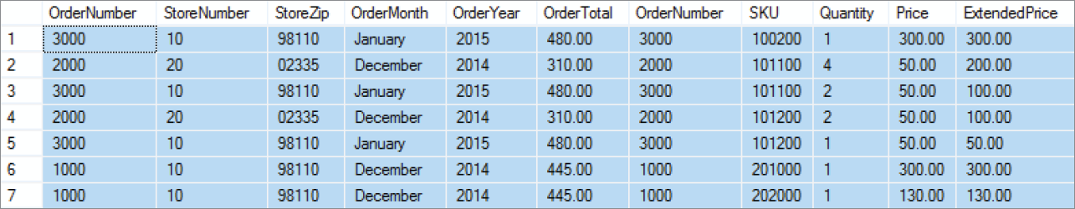
Implicit INNER JOIN
See Page 123

Slide 42
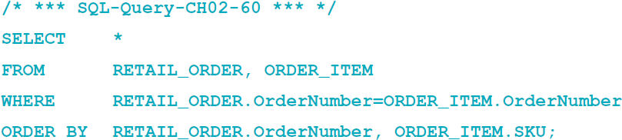
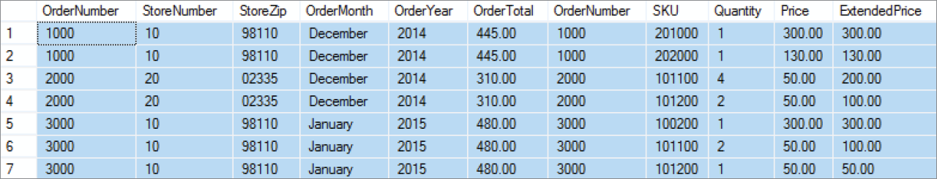
Implicit INNER JOIN with ORDER
With an SQL ORDER BY clause for easier reading by OrderNumber:

Slide 43
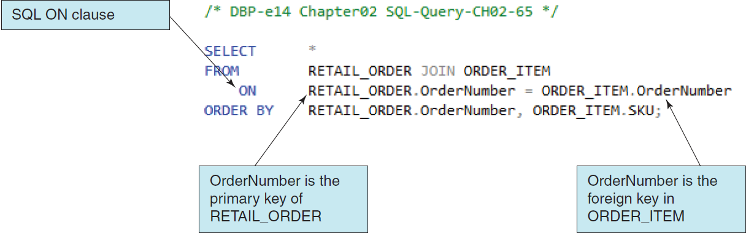
Explicit SQL INNER JOIN
By selecting rows by matching by the primary key values of one table with the foreign key values of a second table, we produce an SQL INNER JOIN.
Because the SQL JOIN keyword does appear in the SQL statement, this is an explicit join.

Slide 44
SQL JOIN ON Syntax
In SQL JOIN ON syntax:
  The SQL JOIN keyword is placed between the table names in the SQL FROM clause, where it replaces the comma that previously separated the two table names, and
  The SQL ON keyword now leads into an SQL ON clause, which includes the statement of matching key values that was previously in an SQL WHERE clause.
  The SQL WHERE clause is no longer used as part of the join, which makes it easier to read the actual restrictions on the rows in the query in the SQL WHERE clause itself.
The explicit SQL JOIN ON syntax is currently considered as the proper way to write SQL join operations, and the older implicit SQL syntax is considered an archaic, older syntax (but it still works).

Slide 45
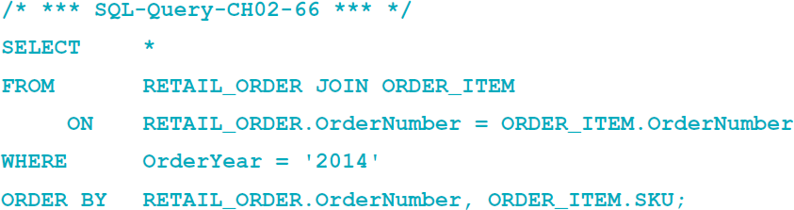
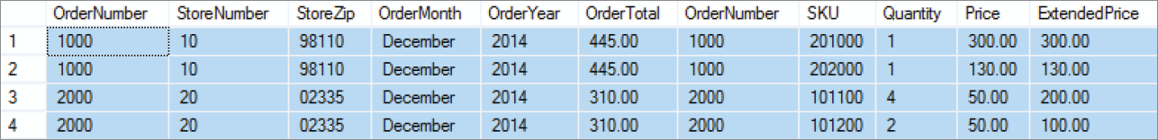
SQL JOIN ON Syntax

Slide 46
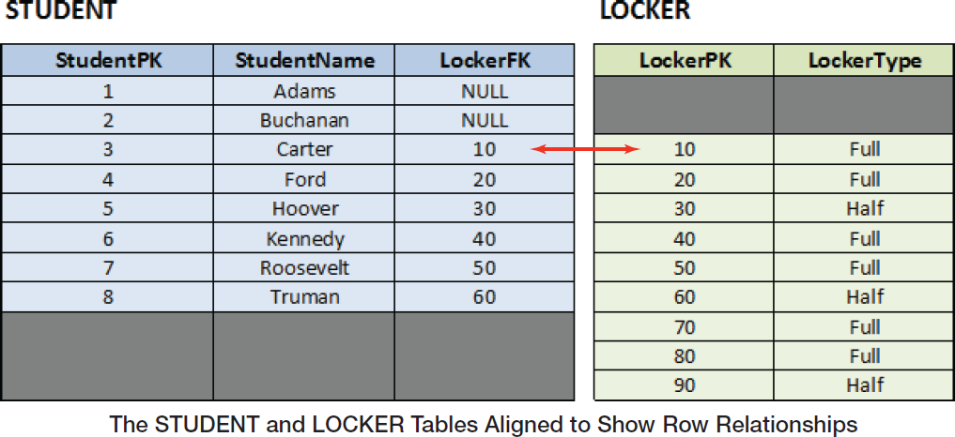
SQL Outer Joins
Example Tables
See Page 132(131~133)

Slide 47
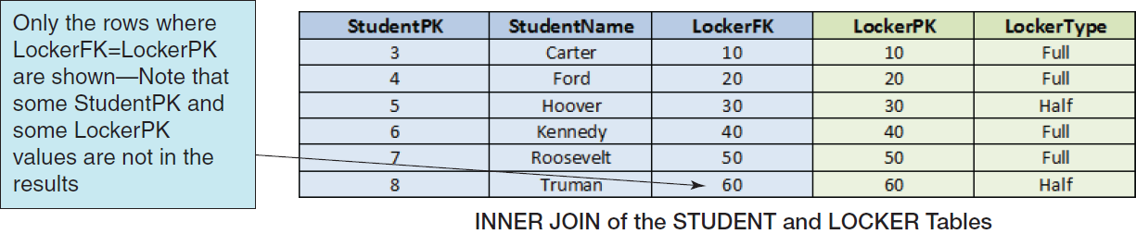
SQL INNER JOIN

Slide 48
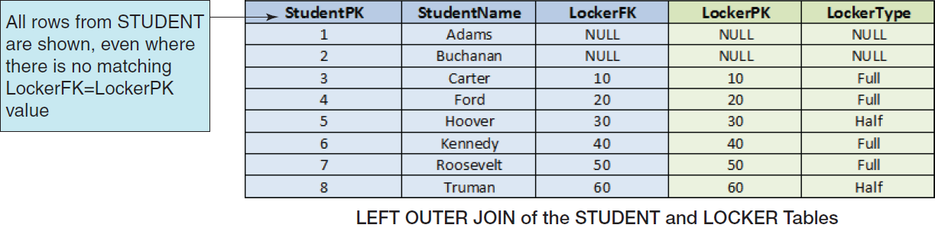
SQL LEFT OUTER JOIN

Slide 49
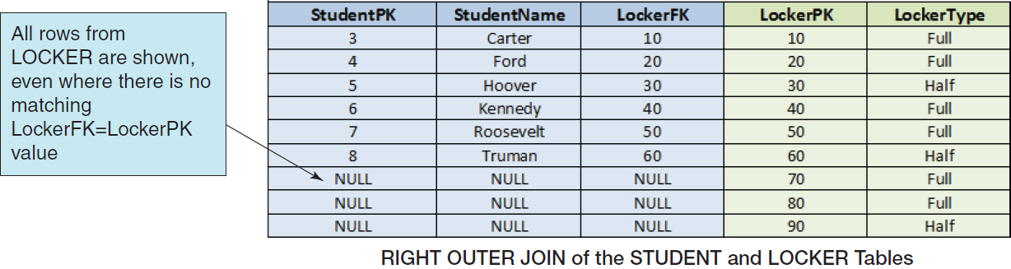
SQL RIGHT OUTER JOIN

Slide 50
Querying Multiple Tables with
SQL Set Operators
Mathematicians use the term set theory to describe mathematical operations on sets, where a set is defined as a group of distinct items.
A relational database table meets the definition of a set, so it is little wonder that SQL includes a group of set operators for use with SQL queries.

Slide 51
SQL Set Operators
A set is represented by a labeled circle.
A subset is a portion of a set that is contained entirely within the set.
The union of two sets represents a set that contains all values in both sets. This is equivalent to an OR logical operation
(A OR B).
The intersection of two sets represents the area common to both sets. This is equivalent to an AND logical operation
(A AND B).
The complement of set B in set A represents everything in set A that is not in set B. This is equivalent to a logical operation using NOT (A NOT B).

Slide 52
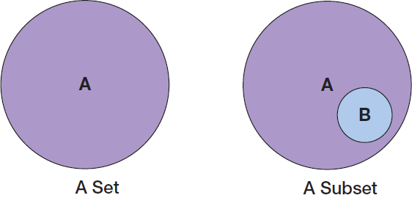
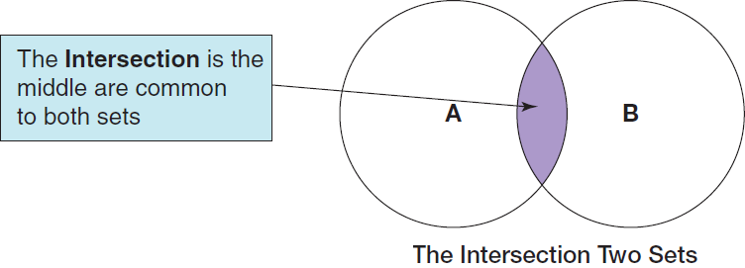
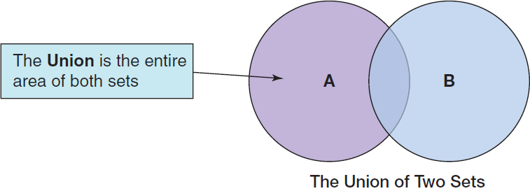
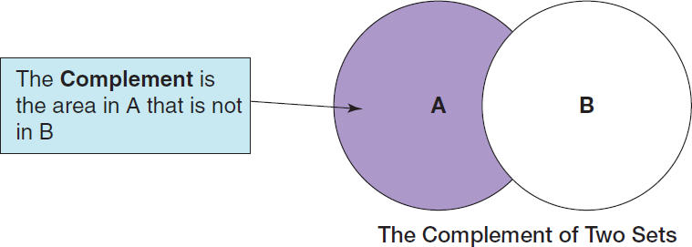

Slide 53
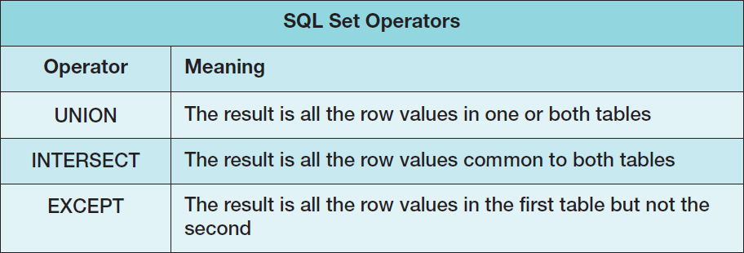
Note that in order to use SQL set operators, the table columns involved in the operations must be the same number in each SELECT component, and corresponding columns must have the same or compatible (e.g., CHAR and VARCHAR) data types!

Slide 54
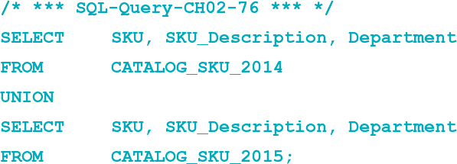
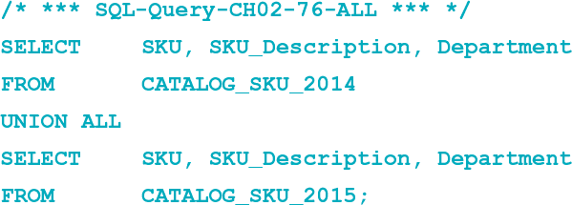
Querying Multiple Tables with SQL Set Operators
The Logic of Set Operators VIII – SQL UNION Operator
“What products were available for sale (by either catalog or Web site) in 2014 and 2015?”
See Page 136

Slide 55
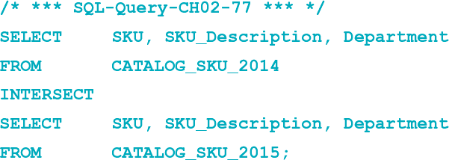
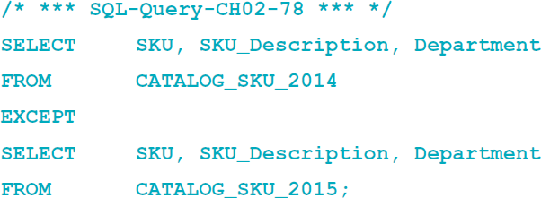
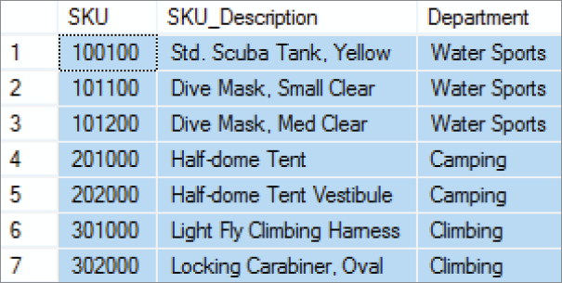
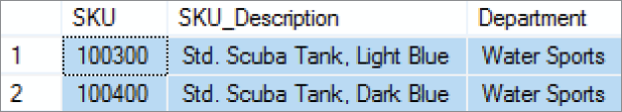
SQL INTERSECT & EXCEPT Operator

Slide 56
Homework
2.34 – 2.60

